Slide 1

Don’t miss out! Register today and join developers from across the country to learn, network and experience the OSS .NET mojo!
Dallas, Texas
October 25-27, 2015
DotNetUnboxed.net
@dotnetunboxed
Special offer for ADNUG members: $99 with code ADNUGDISC

Slide 2




What’s New in C# 6.0
Jimmy Bogard
@jbogard
github.com/jbogard
jimmybogard.lostechies.com

Slide 3
Disclaimers

Slide 4
History Lesson

Slide 5
C# History
1 – “Better than Java”
2 – generics, nullables, anonymous methods
3 – “var”, initializers, anonymous types, lambda expressions, extension methods, LINQ
4 – dynamic, optional parameters, generic variance
5 – async/await

Slide 6
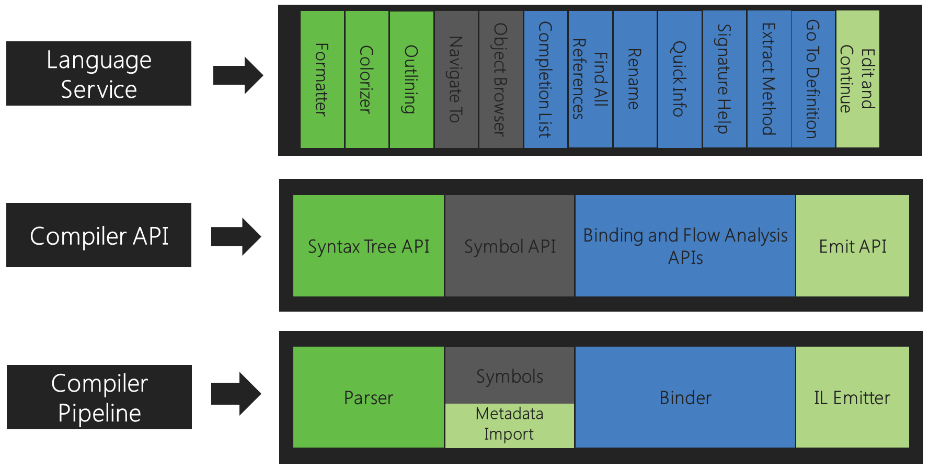
Roslyn

Slide 7
C# 6

